Slide 1

Airbnb’s New User Bookings
Kushagra Sinha
Sagar Khanwalkar
Shambhavi Kumar
Suvrodeep Ghosh
Yasho Vardhan
Notes:
Yasho

Slide 2


Business Problem
Airbnb challenge on Kaggle
Predict country where a new user will make his or her first booking
Airbnb’s strategy - Targeted Marketing
Objective: To help Airbnb identify which users to target for country-specific advertisements and offers depending on their usage stats
Notes:
Yasho

Slide 3
Dataset and Our Approach
213000 observations split into 70 and 30 percent of training and test data
Predictors - Age, user signup behavior, demographics, affiliate and device details
All the users from the US
Dependent variable: Destination country 'US', 'FR', 'CA', 'GB', 'ES', 'IT', 'PT', 'NL','DE', 'AU', 'NDF' (no destination found), and 'other'
Our approach
Preliminary analysis and data pre-processing
Built diverse models for multiclass prediction
Business insights
Notes:
Yasho
Preliminary analysis using data visualizations
Try varying models - Sampling and data partitioning
Business insights - our results to benefit AirBnB which we will present to you at the end

Slide 4
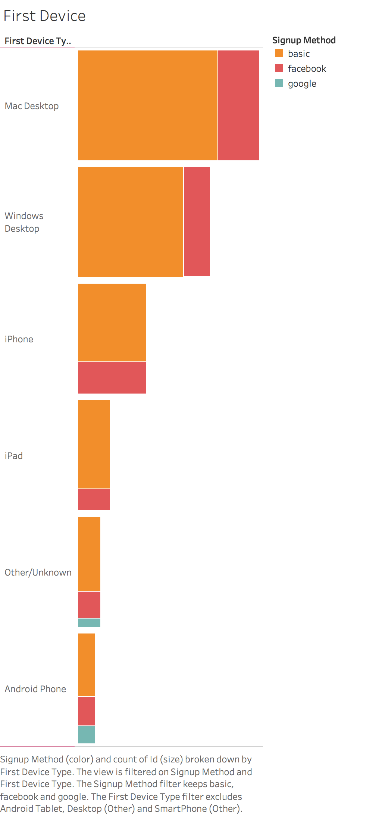
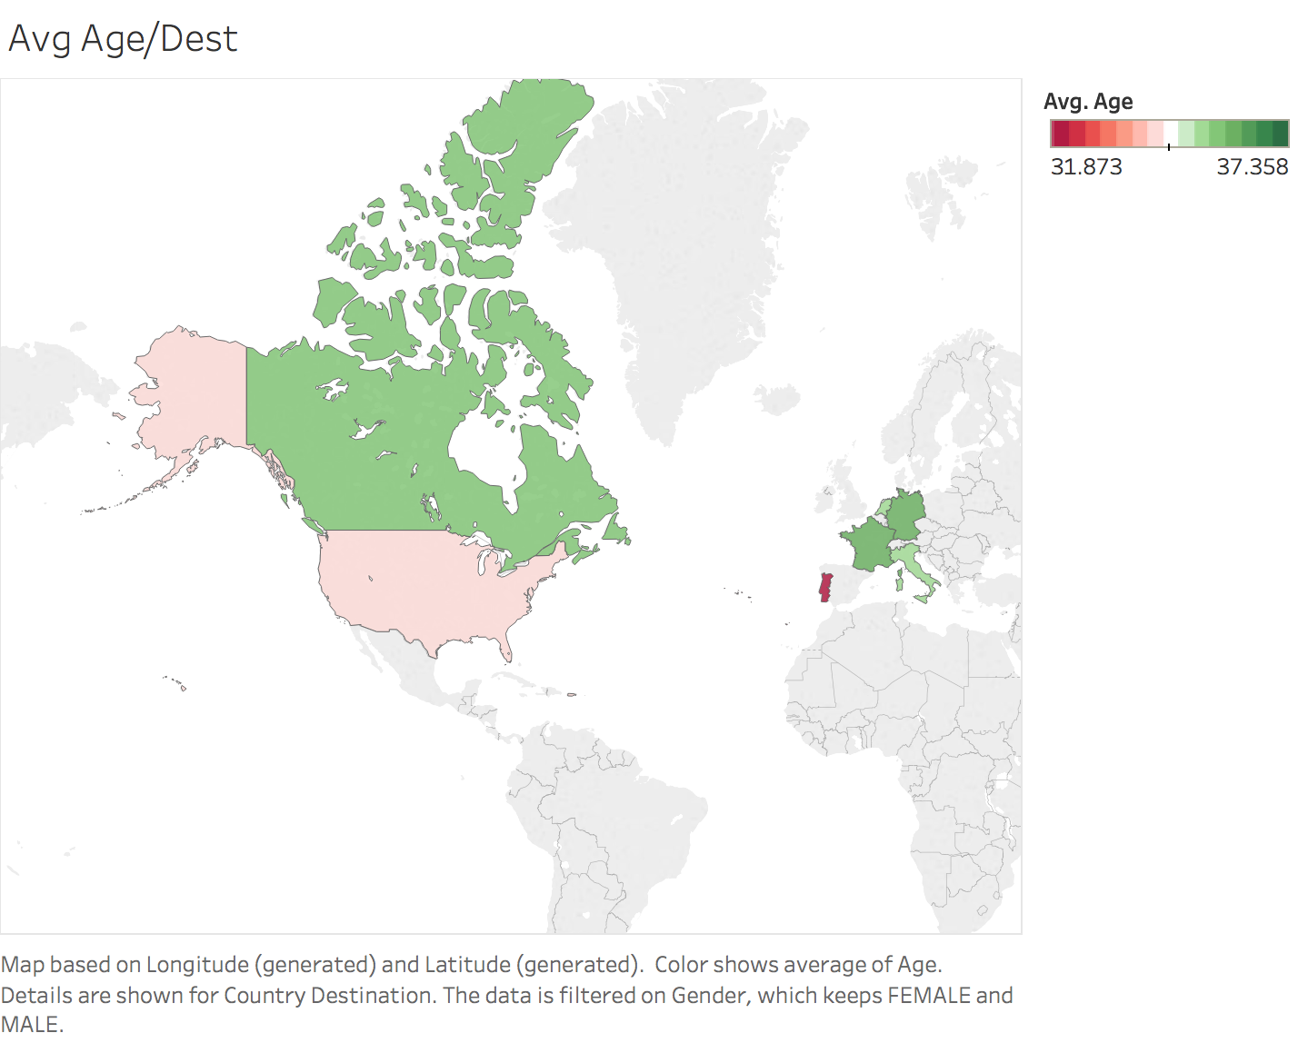
Preliminary Analysis
Notes:
Sagar
Before we cleaned the data we had a certain

Slide 5
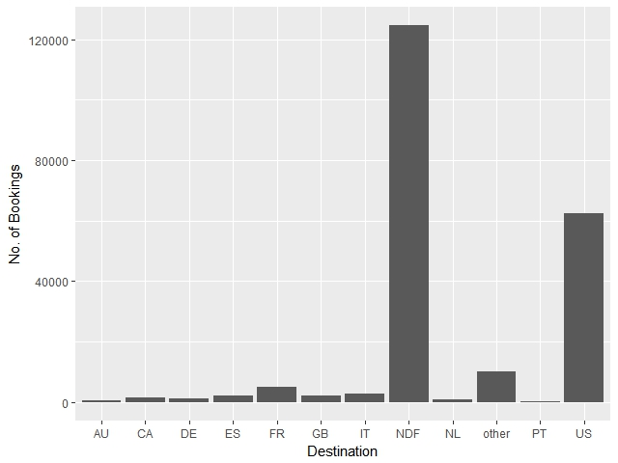
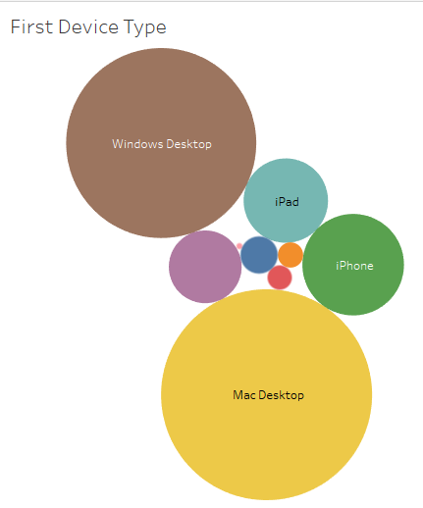
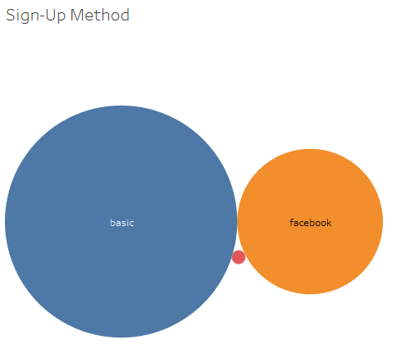
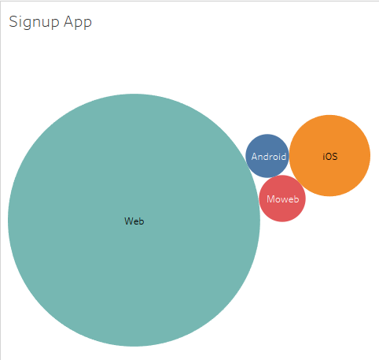
Preliminary Analysis
Notes:
Sagar

Slide 6
Data Preparation
Data Cleaning
Replaced N/A in ‘Age’ → Mean age
Replaced N/A in ‘First Affiliate Tracked’ → “untracked”
Data Transformation
Converted ‘Tiimestamp First Active’ → ‘Date First Active’
Replaced N/A in ‘First Booking Date’ → Adding mean time difference of first active date and first booking date.
Sampling - Partition sampling to make sure training and test
datasets have the same proportions observations of the
12 classes our dataset contained
Notes:
Sagar
Replaced N/A values of ‘Age’ with mean age
Converted ‘Tiimestamp First Active’ to ‘Date First Active’
Replaced N/A values of ‘First Booking Date’ by adding mean time difference of first active date and first booking date.
Filled missing “first affiliate tracked” with “untracked”.
Training set - 149,422 rows
Test set - 64,029 rows

Slide 7
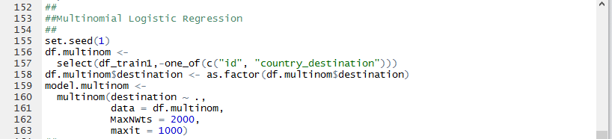
Multinomial Logistic Regression
As a general rule of thumb, we started with Logistic Regression on multiclass predictors.
Fits many independent logistic regression models through a neural network.
Less dependency on collinearity of variables (as was the case with Naive Bayes).
Notes:
Kush
We set the baseline using Multinomial Logistic Regression.
It is also pretty robust to noise and can avoid overfitting.

Slide 8
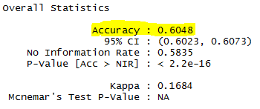
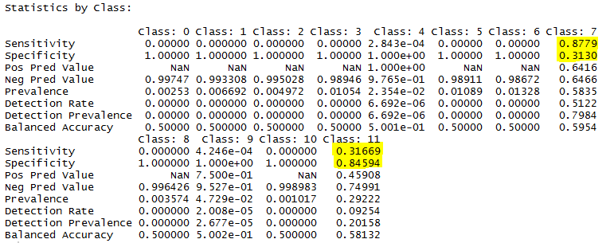
Multinomial Logistic Regression
Accuracy: 0.6048
Notes:
Kush
High sensitivity of class 7 (NDF) is means that it classifies that class correctly roughly 88 times out of 100 times.
For Specificity - 31% of the times that the class was not NDF, it was classified correctly as not NDF.

Slide 9
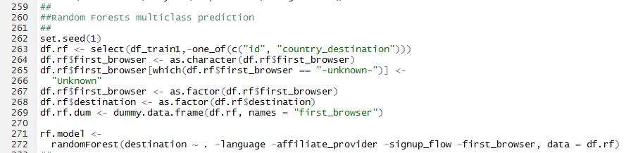
Random Forest
Can handle thousands of input variables without variable deletion.
Random Forest overcomes the overfitting problem encountered by decision trees.
They’re fast and scalable.
Notes:
Kush
they’re fast and scalable, and you don’t have to worry about tuning a bunch of parameters like you do with SVMs, so they seem to be quite popular these days.

Slide 10
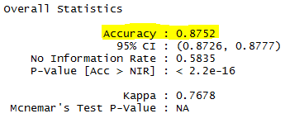
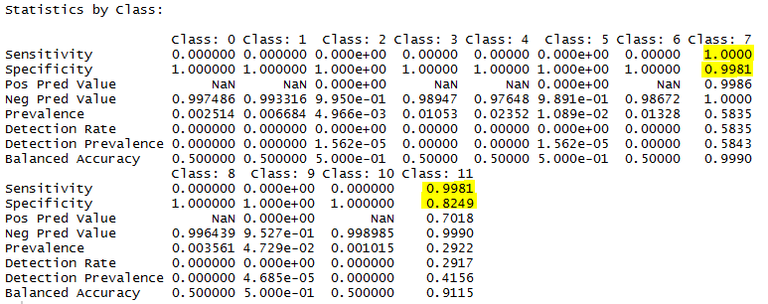
Random Forest
Accuracy: 0.8752
Notes:
Kush

Slide 11
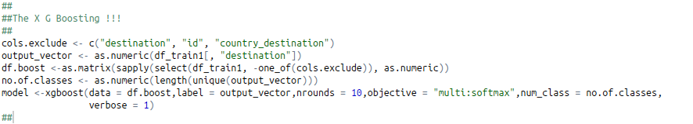
XGBoost
Every predictor variable must be in numerical format.
Achieves better computation time than most ensemble methods
Best method in terms of accuracy with both the training data and the test data.
Notes:
Suvro
Ensemble methods - automatic feature selection

Slide 12
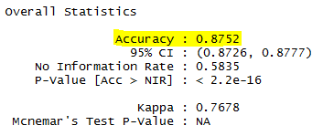
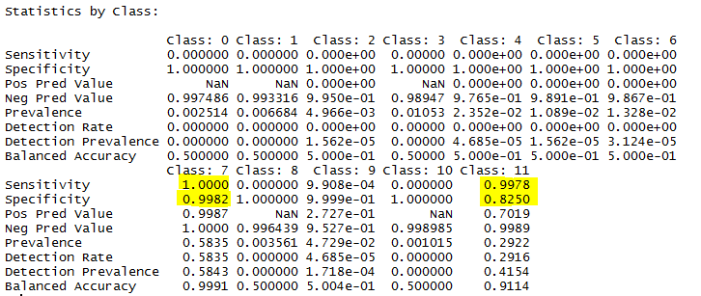
XGBoost
Accuracy: 0.8752
Notes:
Suvro
Ensemble methods - automatic feature selection

Slide 13
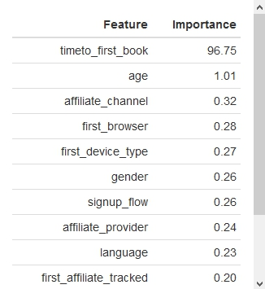
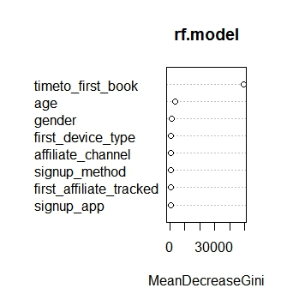
Importance of variables
XG Boost Algorithm
Random Forest Algorithm

Slide 14
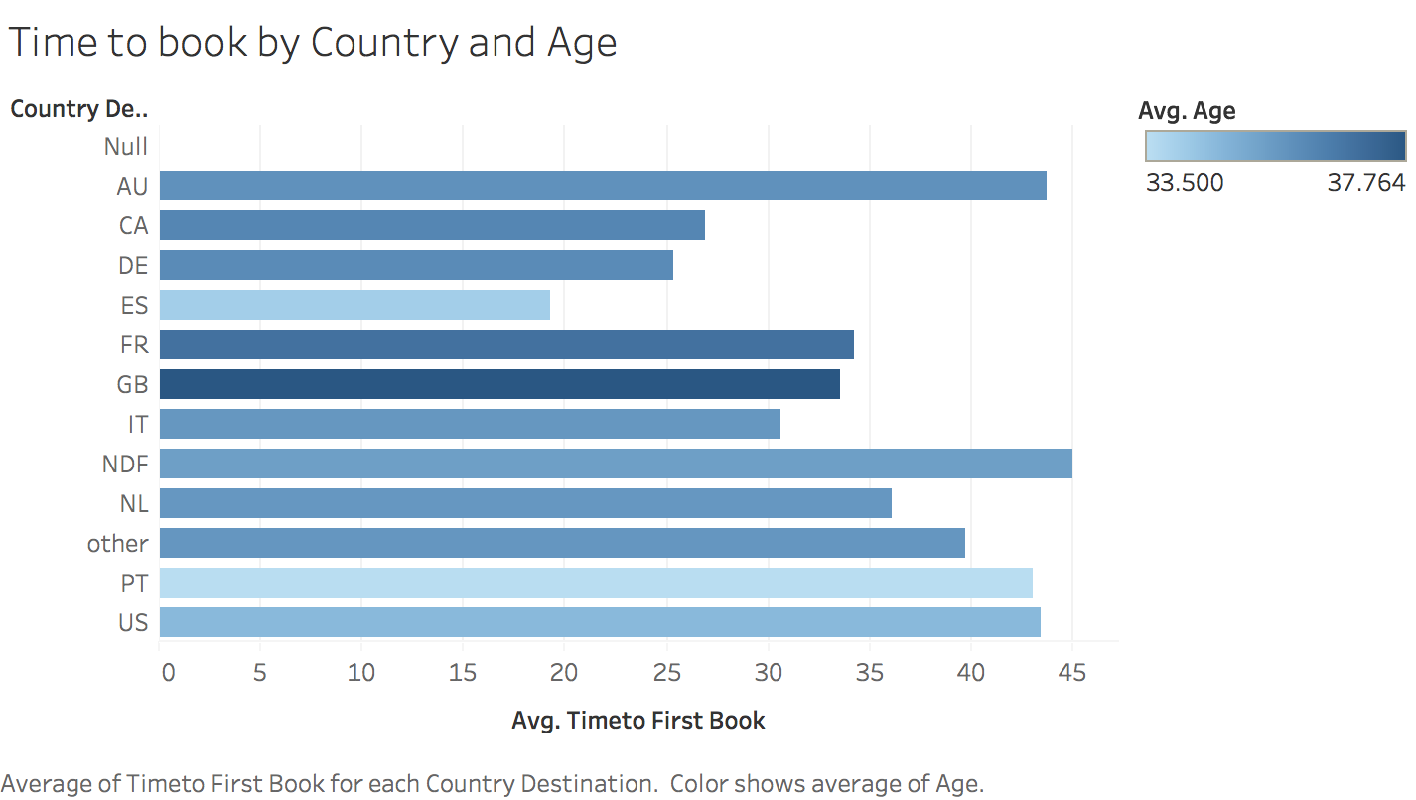
Business Insights
Most significant feature by XGBoost - Time taken to first bookings by 98%
Demographics to identify customer segment, combined with age and gender for customer profiling
Notes:
So what does this mean for AirBnB? By XGBoost, we examine that ‘time taken to first bookings’ is an extremely important feature. Each destination country has a varying average time taken to the first booking. On average, an American who decides to visit Australia takes a much longer time for their first booking whereas an American visiting Spain makes their first booking in less than twenty days.
Demographics such as age and gender are crucial to identifying customer segment - This would aid in targeted marketing. Average age for an American visiting the UK is much higher than the average age for an American using AirBnB for the first time to visit say, Portugal.

Slide 15
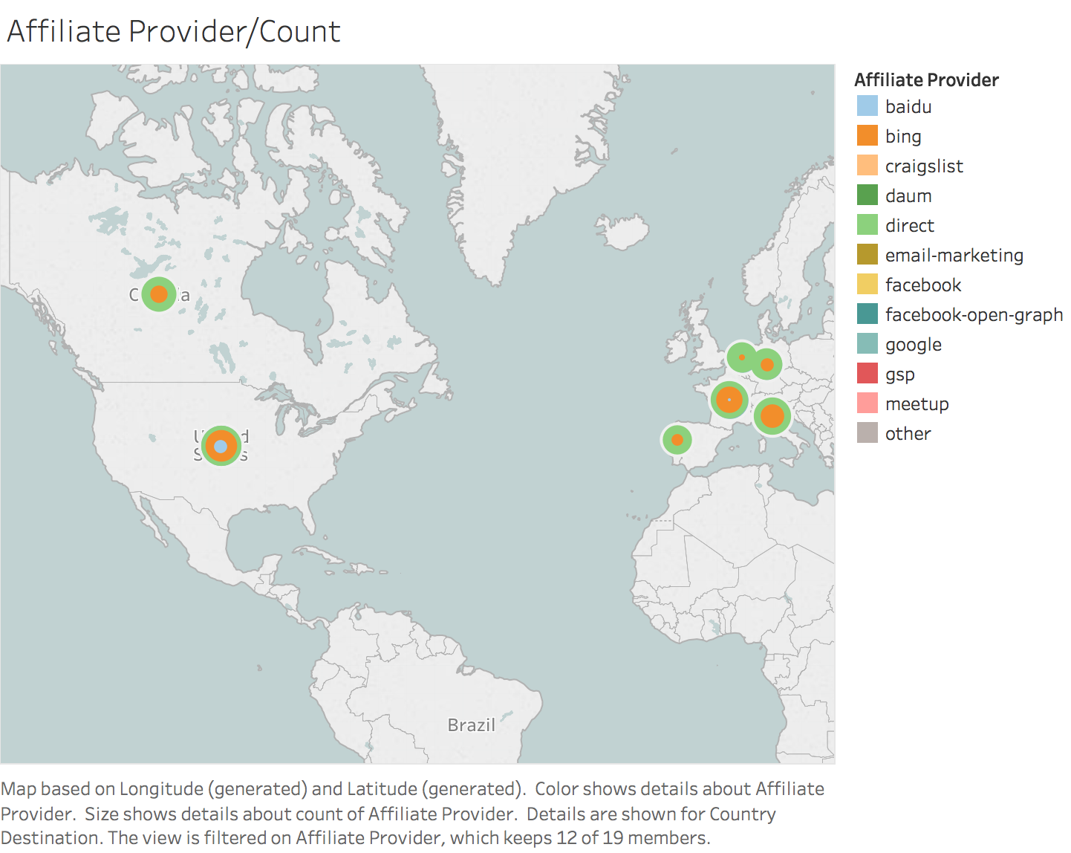
Recommendations
Identify affiliate providers such as Facebook over Google
More data on demographics for customer segmentation and targeted marketing
Users who decline to enter age and gender express low interest and tend to browse rather than book soon
Notes:
Basis our analysis, we have a few additional recommendations for AirBnB.
AirBnB needs to recognize their key affiliate providers through which they garner users. As we can see in the map below, each country has their own distribution of affiliate providers. The size of the bubbles depict the number of users through each affiliate and they’re color coded according to the legend on the right. The largest source is ‘direct users on the website’ followed closely by ‘bing’ as an affiliate - Facebook performs better than Google - We think AirBnB would need to incentivize more affiliates and collaborate with them.
As Sagar mentioned, we performed intensive data preprocessing. We came across many missing values in demographics data. We studied that users who decline to enter age and gender don’t have intentions of making a booking anytime soon. We would need more demographic data for better customer segmentation and we would recommend that AirBnB collects more of this data.

Slide 16
Thank you!
Questions?
Notes:
‹#›

